Slide 1

DOCTOPRO –A secure system for data medical authentication system
MASTER OF COMPUTER APPLICATION
Presented By:
Student Name : OM GUPTA
Roll No : 10071022048
Registration No : 221000512114
Guided By:
Mr. Sanchayan Bhaumik
Department of Computer Application.
Maulana Abul Kalam Azad University Technology, West Bengal, India

Slide 2
Motivation
In the rapidly evolving landscape of healthcare, the adoption of a secure web-based authentication system for medical data is a game-changer. This technological advancement offers healthcare providers a flexible and efficient means of accessing and managing patient information while maintaining the highest standards of security. With this system in place, healthcare professionals can securely log in from anywhere with internet access, ensuring timely and accurate patient care. Leveraging state-of-the-art encryption, user verification methods, and stringent access controls, this web-based authentication system fortifies the confidentiality and integrity of sensitive medical data. It empowers healthcare institutions to streamline their operations, enhance collaboration, and embrace the digital transformation, all while upholding the trust and security of the healthcare ecosystem

Slide 3
In the ever-evolving realm of healthcare, the adoption of a robust and secure web-based authentication system for medical data stands as a pivotal advancement. This innovative technology promises to revolutionize the way healthcare providers interact with patient information, ensuring both accessibility and top-tier security. The intrinsic motivation behind the implementation of such a system is rooted in several key factors:
Accessibility and Flexibility: With this web-based authentication system, healthcare professionals gain unprecedented access to critical patient data. Regardless of their physical location, as long as they have an internet connection, they can securely log in. This level of accessibility ensures that no matter the circumstances, patients can receive timely and accurate care, even in emergency situations.
Data Security: The cornerstone of this authentication system is its unwavering commitment to data security. By deploying state-of-the-art encryption techniques, stringent user verification methods, and meticulous access controls, the system erects an impenetrable fortress around sensitive medical data. The result is a healthcare landscape where patient confidentiality and data integrity are non-negotiable.
Trust and Integrity: Maintaining trust and integrity within the healthcare sector is not negotiable. Patients and their families must have complete confidence in the security of their medical data. The implementation of this secure web-based authentication system serves to reinforce that trust. It sends a clear message that healthcare providers are committed to safeguarding patient information, no matter where it is accessed or shared.
Necessity for the Future: As the healthcare industry continues to evolve, the need for a secure web-based authentication system becomes increasingly critical. The interconnected nature of modern healthcare demands a digital infrastructure that is not just convenient but a necessity for patient safety and quality care delivery.

Slide 4
Why we need this System ?
The motivation behind the adoption of a secure web-based authentication system for medical data extends far beyond mere convenience. It embodies a commitment to patient care, data security, operational efficiency, collaboration, trust, and the future of healthcare. It represents a pivotal step forward in ensuring the highest standards of care while preserving the sanctity of sensitive medical information.

Slide 5
Literature Review
Title | Year | Sort description | Result | Future Scope
A Blockchain Based Data Aggregation and Group Authentication Data Aggregation . | 2020 | The paper proposes a Blockchain-based data aggregation and group authentication scheme for an electronic medical system. | The system aims to secure patient privacy and provide more personal healthcare services. The authors propose a data aggregation scheme based on Blockchain technology for medical environments, allowing multiple authorized users to freely access patient's personal health records. The group authentication mechanism ensures that sensitive information is protected by a group session key. | The system also requires updating the group session key when a new member joins or an old member leaves. The proposed scheme aims to make the electronic medical system more secure, reliable, and useful. The authors note that electronic medical records (EMR), electronic health records (EHR), and personal health records (PHR) are widely used in medical fields for real-time telemedicine and medical diagnostics..

Slide 6
A Privacy-Preserving Optimization of Neighbourhood-Based Recommendation for Medical-Aided Diagnosis and Treatment. | 2021 | The article proposes a privacy-preserving optimization of the neighborhood-based recommendation scheme (PPO-NBR) to provide secure and privacy-preserving recommendations for medical-aided diagnosis and treatment without revealing patients' sensitive information. | The proposed method employs a privacy-preserving medical graph construction protocol and a medical treatment recommendation protocol to implement secure recommendations on encrypted medical data. The BGN Cryptosystem is used as the building module to encrypt data, and graph theory is applied to expand neighbors to search the best similar features. | BLS signature is used for authentication, and a (t, n) oblivious transfer protocol is deployed to preserve the confidentiality of recommendation.
A Provable Secure and Lightweight Smart Healthcare Cyber-Physical System With Public Verifiability. | 2022 | Cyber-attacks have compromised patients' data security and privacy in healthcare. | cyber-physical systems (CPS) in the era of health 4.0, which integrates BioMedical sensors, Internet of Things (IoT), and cloud technologies. | The current research problem with a secure healthcare system for resource-constrained environments is the cost at which a secure healthcare system is achieved. Most existing systems either preserve security and privacy but could not be suitable for a limited resource environment or achieve efficiency but are later found insecure. .

Slide 7
A Reliable Password-based User Authentication Scheme for Web-based Human Genome Database System. | 2011 | The Human Genome Project has led to the development of a Web-based Human Genome Database System (WHGDS) at National Taiwan University Hospital. DNA sequencing is crucial for basic biological processes, genetic diagnosis, and forensic research. | This system integrates sequence alignment and data compression modules, ensuring secure access over insecure networks. A password-based user authentication scheme is proposed for the system due to its convenience, efficiency, and simplicity for human memory. | DNA sequencing is crucial for basic biological processes, genetic diagnosis, and forensic research. The system integrates NCBI BLAST tools with RepBase and RefSeq databases, offering an autoaligning mechanism for sequences uploaded by users. It also compresses sequences by encoding mismatches, reducing storage space demand The system integrates NCBI BLAST tools with RepBase and RefSeq databases, offering an autoaligning mechanism for sequences uploaded by users. It also compresses sequences by encoding mismatches, reducing storage space demand.
A Secure Three-Factor User Authentication Protocol With Forward Secrecy for Wireless Medical Sensor Network Systems. | 2020 | This paper proposes an ECC-based secure three-factor authentication protocol with forward secrecy for WMSNs. | Information and fuzzy verifier and honey_list techniques to solve the contradiction of local password verification and mobile device lost attack. The security of the protocol is evaluated using provable security, Proverif tool, and information analysis. | Utilizing a fuzzy commitment scheme to handle biometric . Comparisons with relevant protocols are given, and the results indicate that the protocol is robust and secure for WMSN systems .

Slide 8
A secure WebRTC/WoT-based Health-care Architecture enhanced with Access Control. | 2019 | This paper presents an e-health architecture that provides secure remote medical services using WebRTC (Web Real-Time Communication. | The goal is to allow patients to benefit from medical assistance by calling remote medical support using real-time multimedia communication technology. | The advancement of medical devices and the emergence of Web of Things (WoT) frameworks make this approach possible, allowing users to monitor their health status and awareness of their health condition
An Authentic-Based Privacy Preservation Protocol for Smart e-Healthcare Systems in IoT. | 2019 | The Internet of Things (IoT) is a rapidly changing technology that involves tiny sensing devices and smart gateways to collect and analyze real-time data remotely. | To prevent illegal access, authentication and key agreement (AKA) is preferred. In the medical industry, the Internet of Medical Things (IoM) is used to gather and analyze patient physiological parameters. The security protection and privacy of medical data are becoming a challenging issue in the IoM. The paper proves that an adversary cannot impersonate as a legitimate user to illegally access or revoke the smart handheld card. | An anonymity-based user authentication protocol is preferred to resolve privacy preservation issues. In this paper, a Secure and Anonymous Biometric Based User Authentication Scheme (SAB-UAS) is proposed to ensure secure communication in healthcare applications.

Slide 9
An Efficient and Certificateless Conditional Privacy-Preserving Authentication Scheme for Wireless Body Area Networks Big Data Services. | 2018 | This paper proposes an efficient and certificateless conditional privacy-preserving authentication scheme for Wireless Body Area Networks (WBANs) big data services. | The study aims to ensure the security and privacy of patient's physiological data in WBANs, which are large and require big data services. Traditional methods for processing these large data are inefficient and secure, making big data services necessary. The proposed scheme is based on big data, making it better than traditional WBANs. | . It supports batch authentication of multiple clients, reducing the computational overhead of the application provider. The scheme provides anonymity, un-linkability, mutual authentication, traceability, session key establishment, forward secrecy, and attack resistance
An Identity-Based Authentication Protocol for the Telecare Medical Information System (TMIS) Using a Physically Unclonable Function. | 2022 | The Telecare Medical Information System (TMIS) allows patients to securely exchange their health data with a remote medical server for real-time remote diagnosis.. The informal security evaluation suggests that the proposed model effectively counters numerous security threats faced by modern TMIS-based protocols. | . To address privacy and security concerns, a secure authentication mechanism is essential. This study introduces an extended authentication scheme with robust anonymity for the Internet-of-Things-enabled multiserver infrastructure in the TMIS using a physically unclonable function. | The informal security evaluation suggests that the proposed model effectively counters numerous security threats faced by modern TMIS-based protocols

Slide 10
Anonymous Authentication for Wireless Body Area Networks With Provable Security. | 2017 | Advances in wireless communications, embedded systems, and integrated circuit technologies have made wireless body area networks (WBANs) a promising networking paradigm. | WBANs are increasingly used in modern medical systems for collecting real-time biomedical data through intelligent medical sensors and sending it to remote medical personnel for clinical diagnostics. However, WBANs also present challenges in maintaining data confidentiality and patients' privacy. | In recent years, several anonymous authentication (AA) schemes have been proposed to enhance security by protecting patients' identities and encrypting medical data. However, many of these schemes are not secure enough.
ASSURED PRIVACY AND AUTHENTICATION OF HEALTH DATA IN CLOUD USING CRYPTOGRAPHIC ALGORITHM. | 2018 | In the modern era, healthcare centers and individual care takers create a prolific path to share and store data, reducing healthcare costs. | However, using public clouds for this purpose includes high risks, as data is shared among multiple users, making security issues more deep-rooted and vulnerable to theft. Currently, cloud service providers have full control over the key, making data sharing more vulnerable to theft. | To ensure end-to-end security, protocols are used to protect data among authorized users. The design of webpages helps patients upload encrypted data to the cloud, and authorized users can only download the data if the key is present. Memory usage and encryption time are calculated to provide end-to-end security for sharing health data between a patient and an authorized user. Cryptographic algorithms.

Slide 11
Authenticated Medical Documents Releasing with Privacy Protection and Release Control. | 2021 | The integrity and origin authentication of medical documents released in Information Societies. | The sensitive nature of this information raises a privacy threat when medical documents are uncontrollably made available to untrusted third parties. Redactable signatures (RSSs) allow parties to delete parts of an authenticated document while guaranteeing the origin and integrity authentication of the resulting subdocument. | . However, most existing RSSs are vulnerable to dishonest redactors or illegal redaction detection. To address these issues, the authors propose two distinct RSSs with flexible release control (RSSs-FRC) and analyze their performance in terms of security, efficiency, and functionality. The study highlights the importance of protecting patients' privacy when their medical data is used for secondary use, such as clinical studies and medical research.
Authentication and Secure Key Management in E-Health Services: A Robust and Efficient Protocol Using Biometrics. | 2017 | This article discusses the use of modern technology in medical science, particularly in Telecare Medicine Information Systems (TMIS). | The security of patient-related information is crucial, and authentication protocols have been proposed for this purpose. However, Omid et al.'s protocol is susceptible to user impersonation attacks and fails to protect user identity | To address these issues, an improved mechanism is needed to secure the three-factor authentication framework for practical applications. A robust and efficient biometrics-based authentication and key agreement protocol for E-Health Services has been proposed

Slide 12
COMPUTER-AIDED INTERVENTIONS INFORMATION SYSTEM. | 2018 | The Computer-Aided Interventions Information System (CAIIS) was designed to support image-guided interventions for neurosurgery and radiosurgery activity. | The system includes patient and center management, clinical knowledge system, archiving, and report production. The framework uses a server-side web application based on open, standard, and robust technologies such as Java, XML, JDO, persistence layer (Castor), SQL-transaction enabled Database, HL7, DICOM3.0, and Apache projects. | The system is used by over 30 users to encode treatment data (654 interventions) and patient follow-up (597 for diverse image-guided procedures). The system also collects planning and treatment data, including images, from various medical workstations and archives both online and offline with fully automated management.
CSEF: Cloud-Based Secure and Efficient Framework for Smart Medical System Using ECC. | 2020 | The study by Ashish Kumari and Chien-Ming Chen aims to design a secure and efficient authentication framework for cloud-assisted SMS in smart architecture. | The framework uses elliptic curve cryptography (ECC) and hash function to establish mutual authentication between healthcare centers, patients, doctors, and patients using ECC and hash function. The CSEF is secure against security attacks and satisfies many security attributes such as man-in-the-middle attack, impersonation attack, data non-repudiation, doctor anonymity, replay attack, known-key security property, message authentication, patient anonymity, data confidentiality, stolen-verifier attack, parallel session attack, and session key security. | It is also efficient in terms of computation and communication compared to other related frameworks, making it suitable for cloud-based SMS.

Slide 13
Design of Secure Authentication Protocol for Cloud-Assisted Telecare Medical Information System Using Blockchain. | 2020 | The study focuses on the design of a secure authentication protocol for a cloud-assisted Telecare Medical Information System (TMIS) using blockchain. | The TMIS is implemented in wireless body area networks (WBAN) and uses wearable devices to generate patient health data. However, malicious attackers can attempt attacks through public channels, making secure authentication between patients and servers essential. Wearable devices have limited storage power, making it difficult to store an entire set of health data. | To address this issue, the researchers propose a secure authentication protocol using ciphertext-policy attribute-based encryption (CP-ABE) to establish access control for health data stored in the cloud server and apply blockchain to guarantee data integrity.
Enabling Telecare Medical Information Systems . | 2017 | This paper discusses the challenges of enabling Telecare Medical Information Systems (TMIS) with strong authentication and anonymity. | TMIS is a popular choice for remote access to medical services, but security, such as authentication and privacy preservation, is a challenge. Two-factor authentication schemes have been proposed, but these schemes are not secure against offline dictionary attacks and fail to revoke stolen/lost smart cards. An improved two-factor authentication scheme with anonymity has been proposed to remedy these weaknesses. The security analysis of the proposed solution is formally given using the random oracle model and Burrows–Abadi–Needham logic. | Telecare medical information systems (TMIS) have improved the healthcare process by providing an efficient communication platform on the internet, breaking barriers between patients and doctors.

Slide 14
Lightweight Cloud Computing-Based RFID Authentication Protocols Using PUF for e-Healthcare Systems. | 2023 | Cloud computing services have become increasingly used for e-Healthcare systems, enabling medical staff to remotely access patients' data. | The radio frequency identification (RFID) system is popular for collecting physiological signals, such as heartbeat, blood pressure, pulse, and brain activity. However, these systems have security and efficiency issues, such as time-consuming computations and the difficulty of using public-key cryptosystems | To address these issues, this study proposes authentication key agreement protocols for e-Healthcare systems using physical unclonable function (PUF). PUFs use the uniqueness and randomness of their circuits to perform computation, resulting in message fingerprints acting as authentication keys.
Secure Identity Authentication of Community Medical Internet of Things. | 2019 | The study focuses on the security and privacy in emerging digitalized communication environments, particularly in the community medical Internet of Things (CMIoT) environment. | The IoT system consists of numerous device nodes, network nodes, and user nodes, forming a heterogeneous network. To ensure smooth data exchange, gateway nodes are adopted to connect different network spaces. To identify and authenticate the identities of heterogeneous nodes, the researchers propose a secure and reliable update mechanism for authentication keys and session keys. | This measures effectively ensure the legality of nodes and communication security in the community medical IoT system. The study also analyzes and compares experimental performance, proving that this scheme is more suitable for the scene of the CMIoT.

Slide 15
Security Analysis on “A Secure Three-Factor User Authentication Protocol With Forward Secrecy for Wireless Medical Sensor Network Systems” . | 2017 | The Internet of Things (IoT) has revolutionized various industries, including smart transportation and healthcare, by connecting devices and objects to the internet. | . Wireless sensor networks (WSNs) have become a crucial base for IoT, facilitating data exchange through various technologies. However, data security issues, such as data leakage, have become a significant concern. Researchers have developed various authentication protocols for WMSNs, but many have serious security flaws | Liet al. presented a three-factor user authentication protocol for WMSN, claiming it offers user anonymity and prevents sensor node impersonation attack.

Slide 16
Moral/Gist Of The Journal
This article delves into the integration of modern technology within the field of medical science, with a specific focus on Telecare Medicine Information Systems (TMIS). In this context, the protection of patient-related information is of paramount importance. The article explores the introduction of authentication protocols designed to enhance the security of patient data within TMIS.

Slide 17
Proposed Method
Certainly, elaborate on the use of Public Key Infrastructure (PKI) in a secure authenticator key system, particularly in the context of managing digital profile credential to ensure secure communication and data protection.
Encryption Keys:
PKI also manages encryption keys used for secure communication. The primary types of keys involved are:
Public Key: As mentioned earlier, the public key is included in the digital certificate and can be used for encrypting data that only the certificate holder can decrypt using their private key.
Private Key: The private key is kept confidential and is never shared. It is used for decrypting data that has been encrypted with the corresponding public key. In the context of secure communication, this private key is essential for decoding incoming encrypted data.
In summary, Public Key Infrastructure (PKI) forms the backbone of secure communication and data protection in the context of an authenticator key system. It accomplishes this by managing digital certificates and encryption keys, which provide identity verification, confidentiality, data integrity, and strong security against various threats.

Slide 18
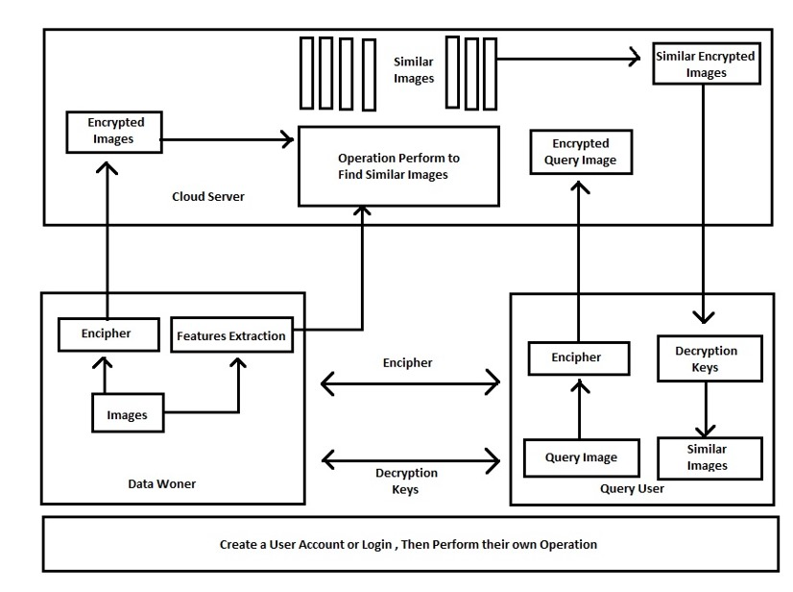
Flow Diagram Of Model

Slide 19
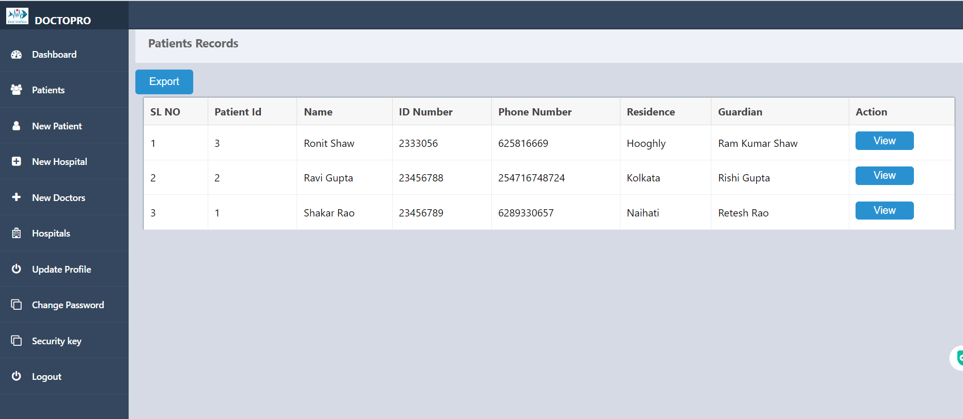
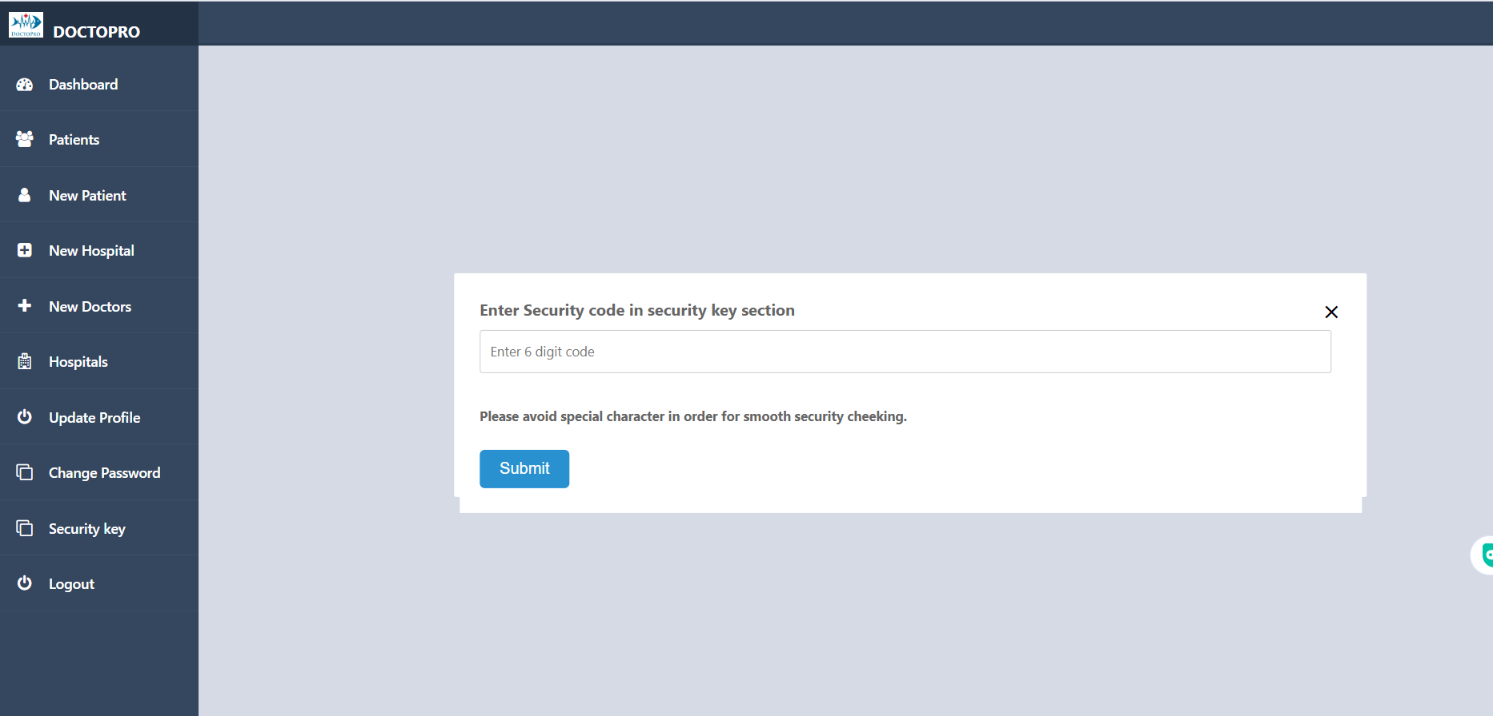
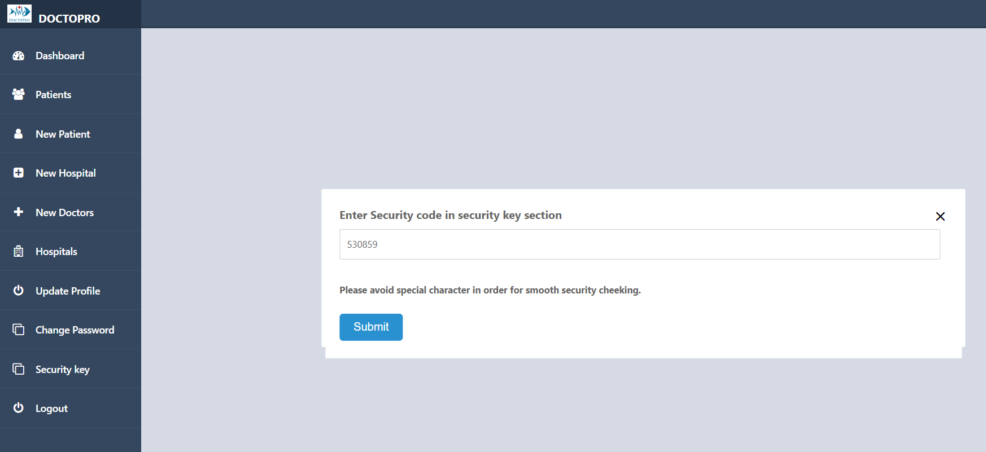
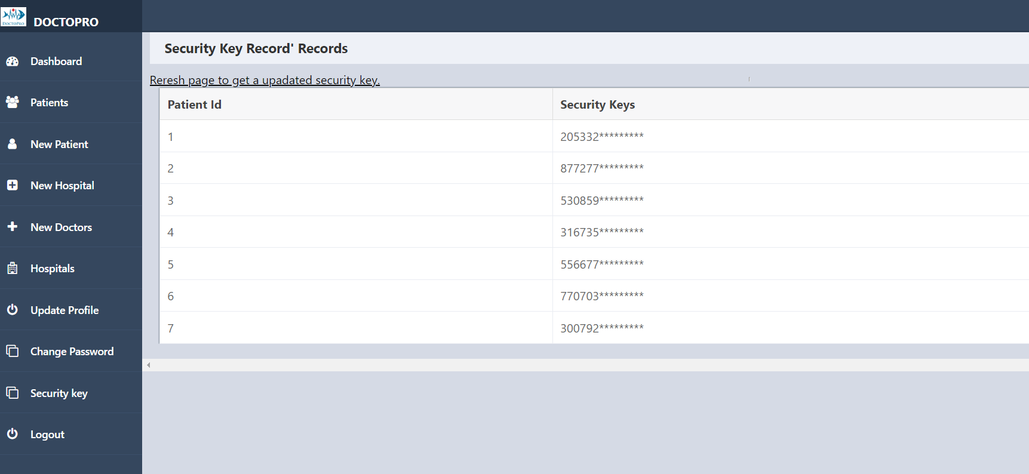
Interface View

Slide 20
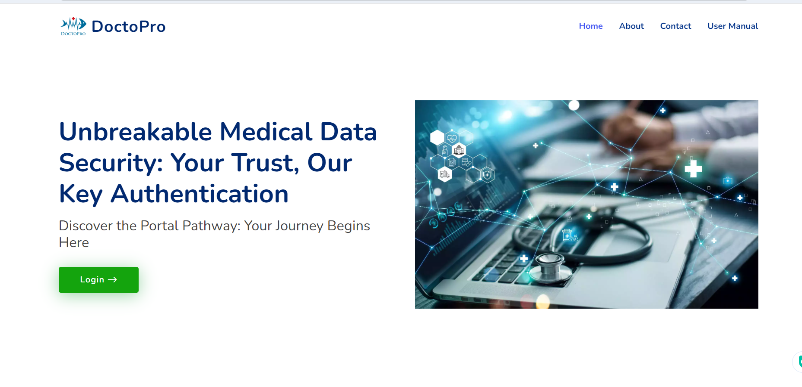
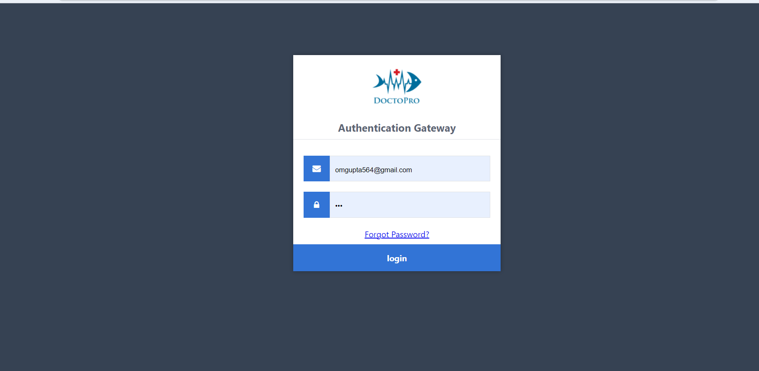
LOGIN INTERFACE

Slide 21
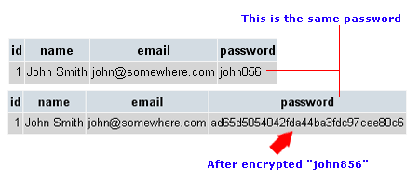
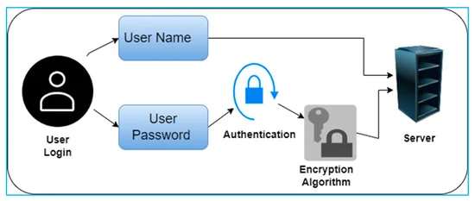
Secure Md5 Encryption at login
MD5 (Message Digest Algorithm 5) is a cryptographic hash function that was widely used in the past but is now considered insecure for most security applications due to several vulnerabilities. MD5 generates a fixed-length, 128-bit hash value from input data of arbitrary length.

Slide 22
Generation of Public Key For Patient Cheek
Generating a secure code for patient check using a random function is a common requirement in healthcare and other fields. To create a secure code, you can use a combination of cryptographic principles and randomization. Below is a step-by-step algorithm to generate a secure patient check code:
Choose a character set: Decide on the character set you want to use for the code. Typically, this includes uppercase letters, lowercase letters, and digits. You can also include special characters for added security.
Determine the code length: Define the desired length of the patient check code. Longer codes are generally more secure.
Generate a cryptographically secure random code:
Use a cryptographic library or a secure random number generator, depending on your programming language.
Generate random characters from the chosen character set.
Ensure that characters are selected with uniform randomness.
View
Six Digit Number
Random(6digit generate)
Refresh/Change as code change as many time view click

Slide 23
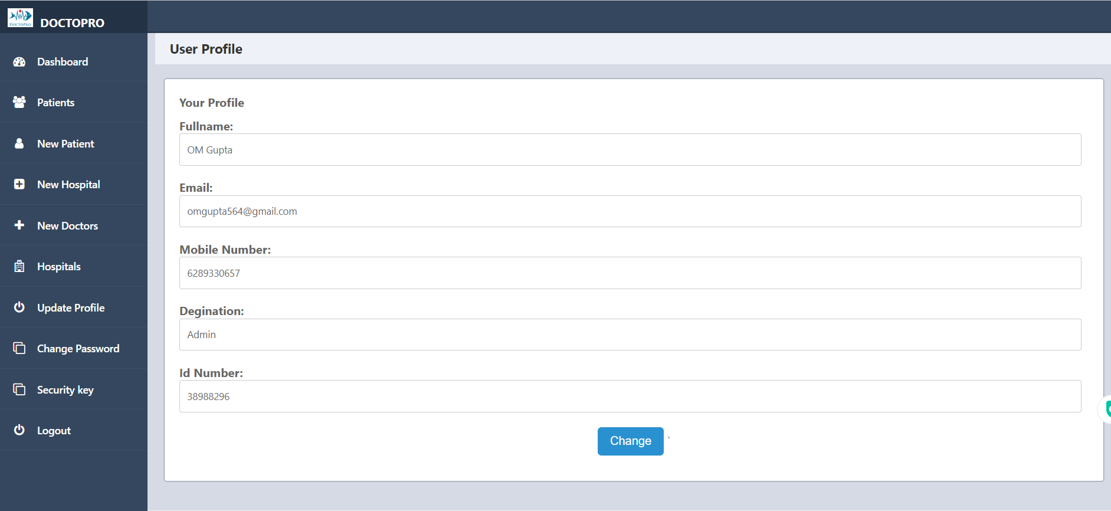
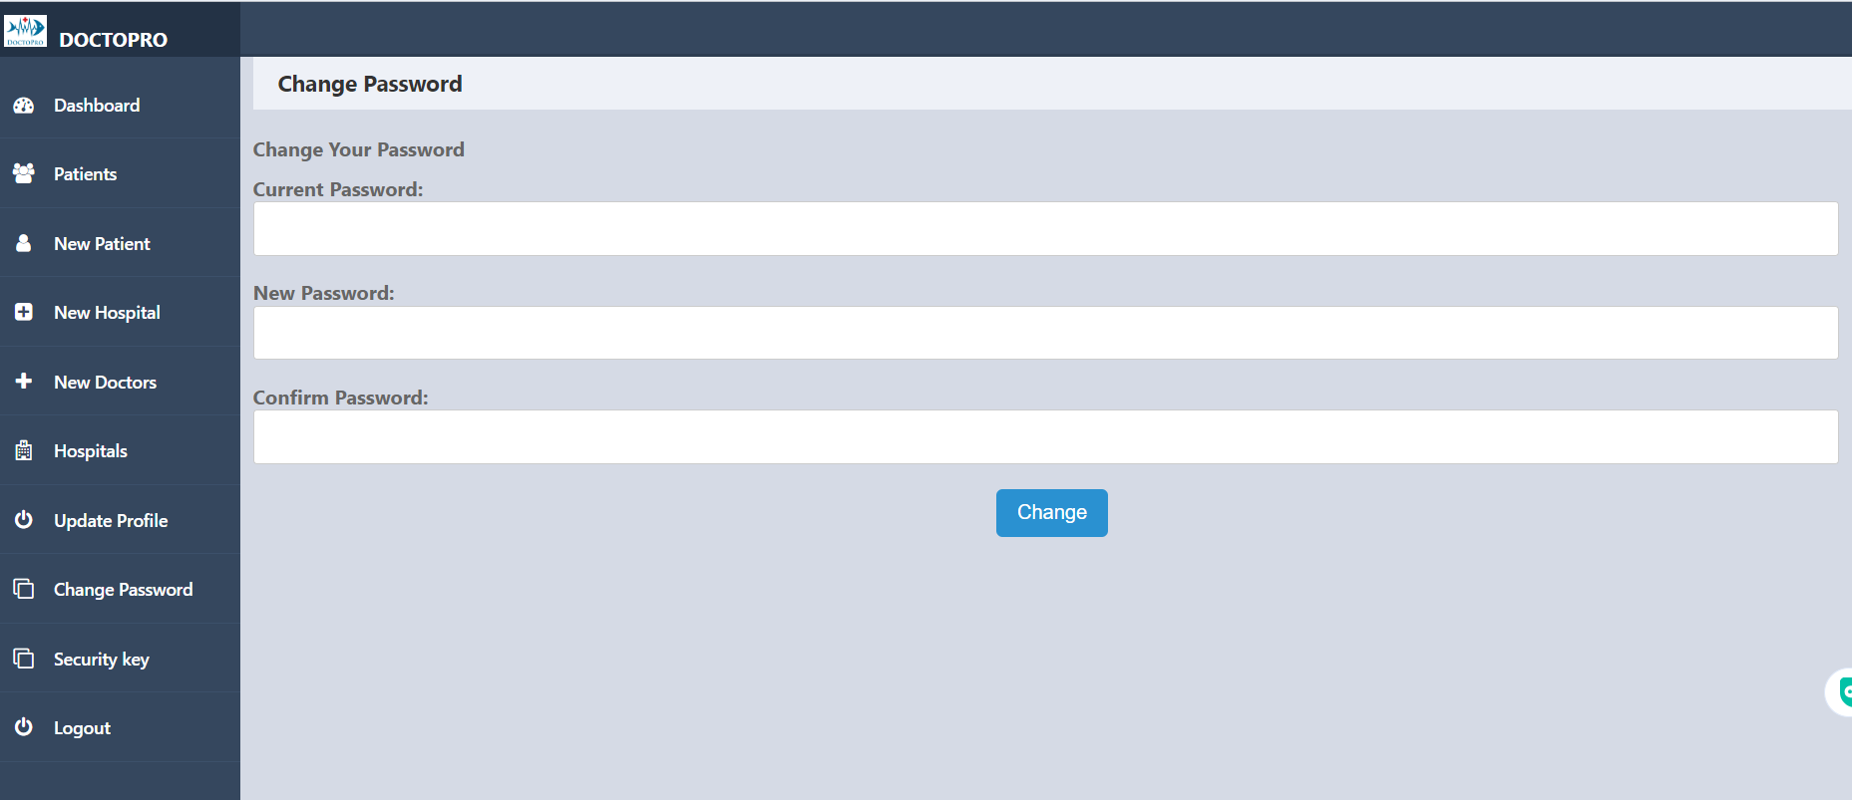
Admin Interface

Slide 24
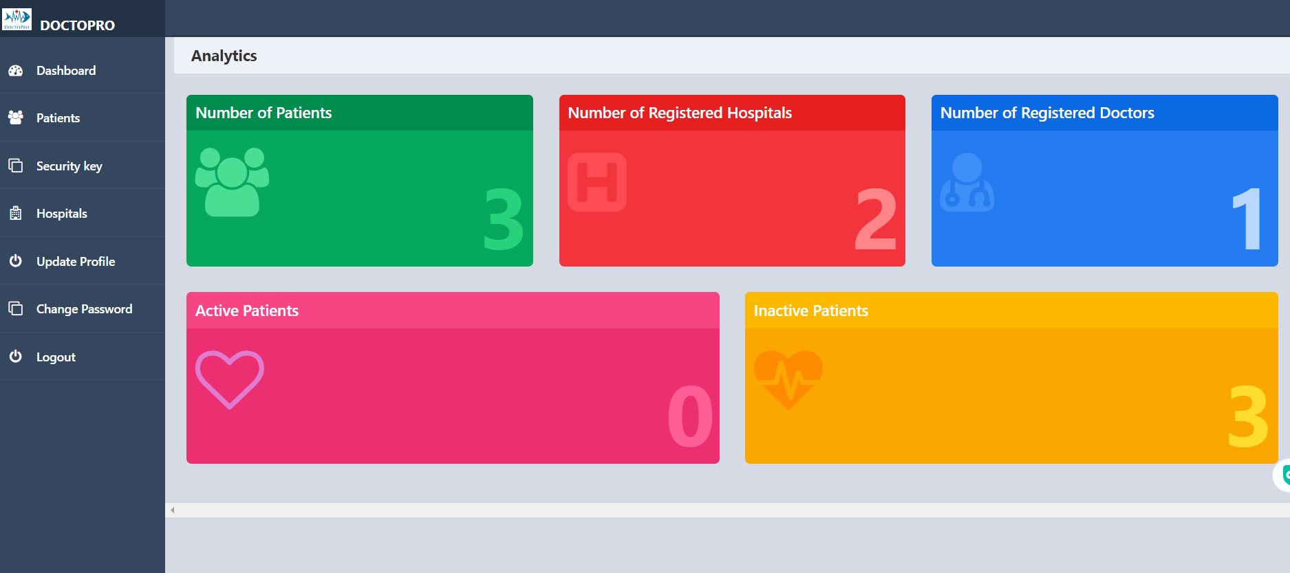
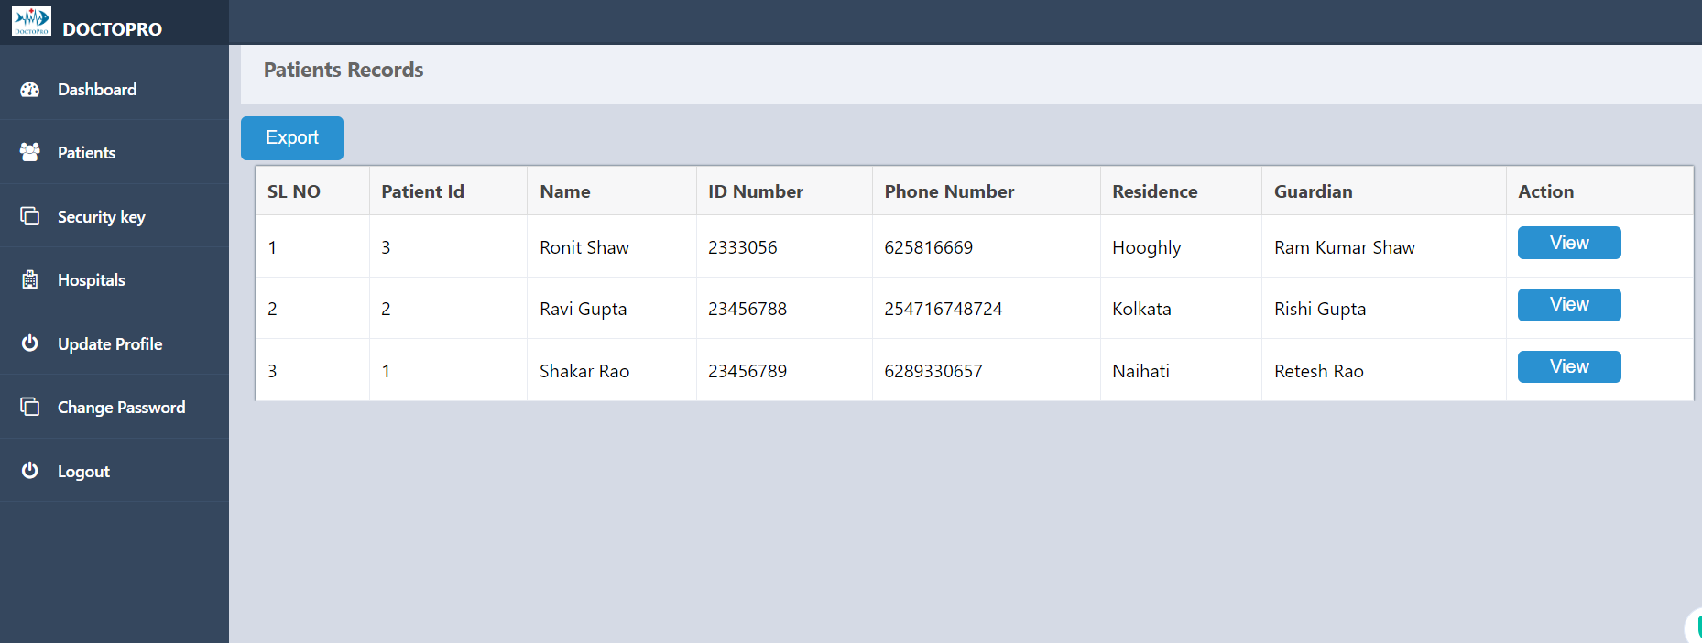
Doctor Interface
Function Of Doctor and Responsibility:-
1. To view a patient by secure key method to view the medical history.
2.To Records the symptoms(active) and discharge it automatically

Slide 25
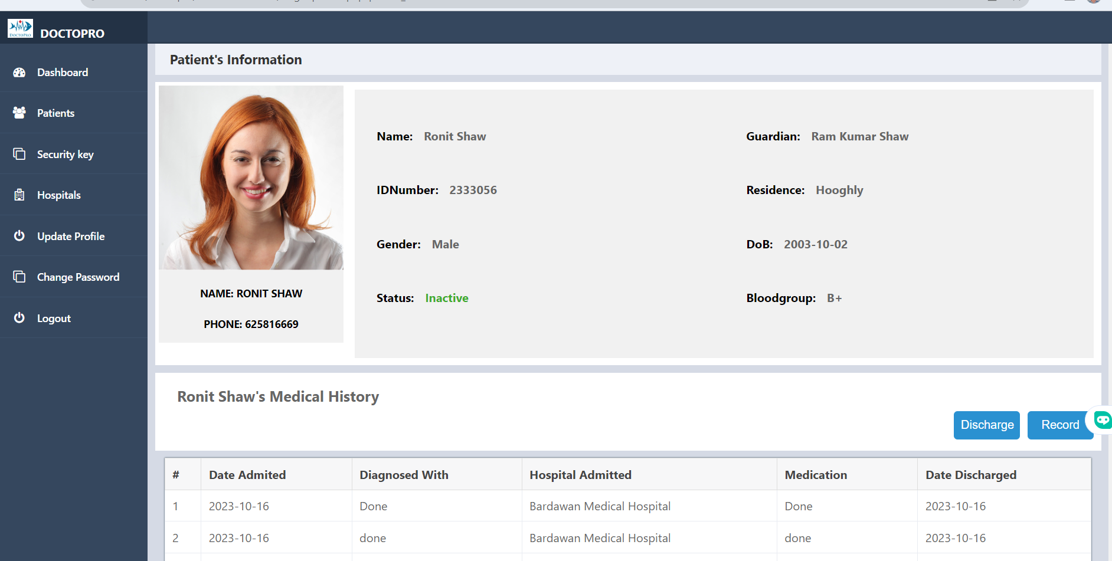
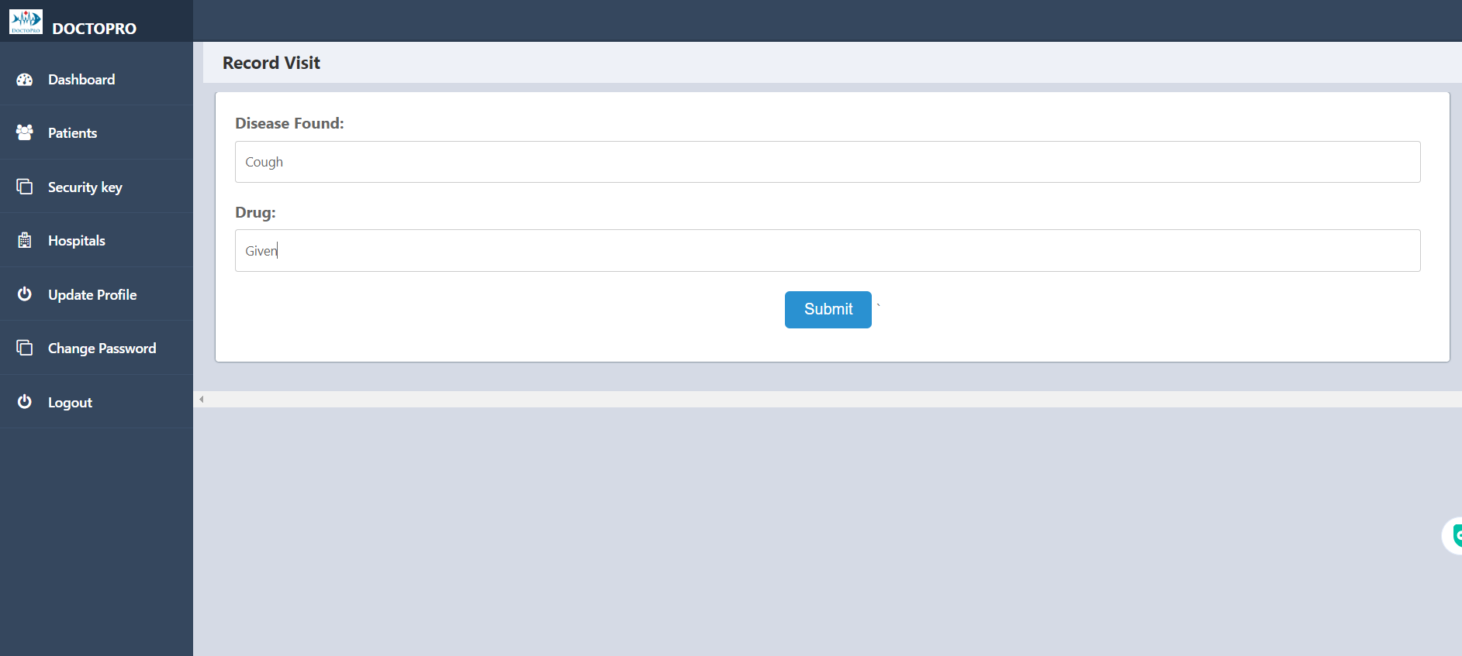
Experimental Results
Admin Result View

Slide 26
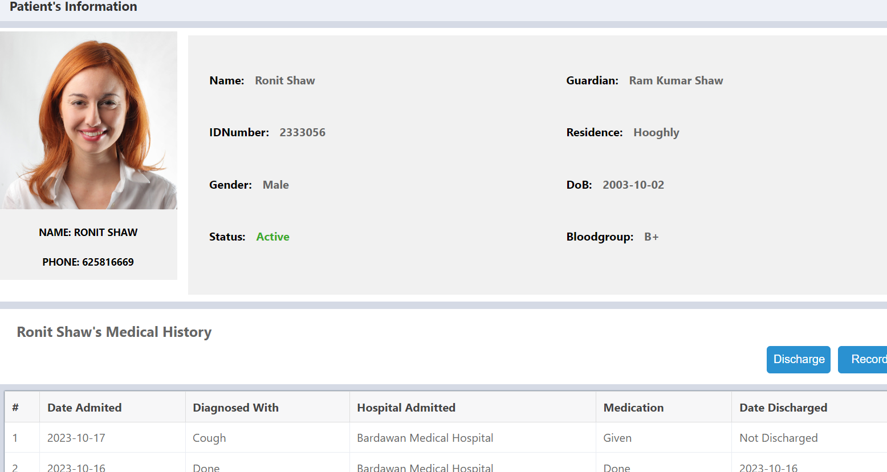
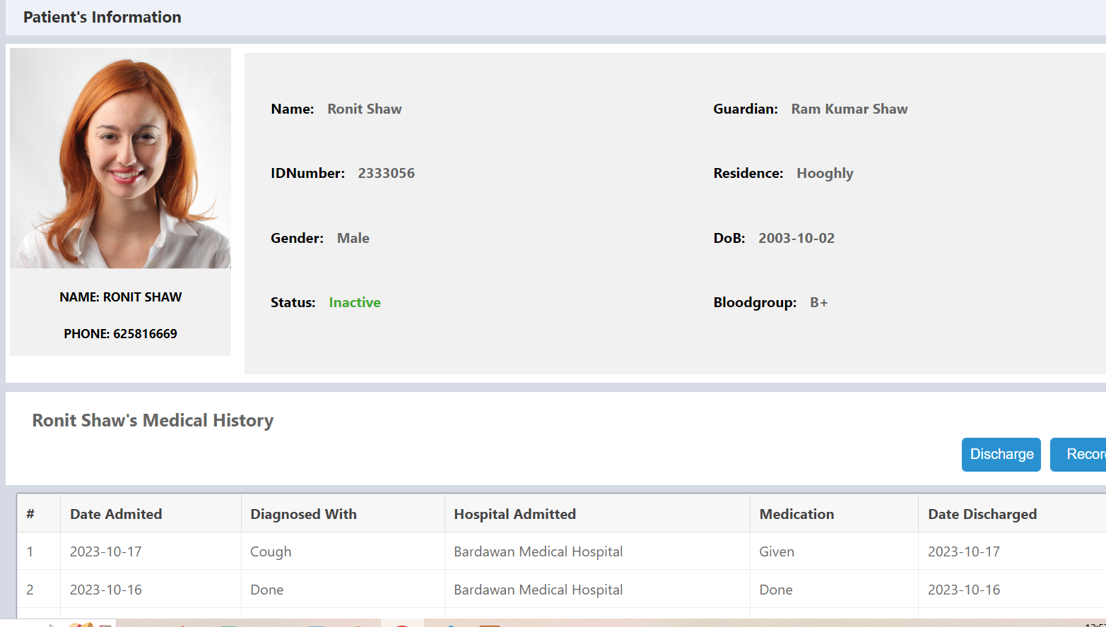
After Update Academic Record is active
After Discharge it is inactive

Slide 27
Output Of Experiments
The experiment will give a clarity that both admin and doctor can view the patients medical history, record, detail and change the active status ,update medicine and feedback by the mean of a random security key that seems to change at the time of the view patients bar will be click and security code for the respective patients id’s is update need to refresh the security key option by random function .

Slide 28
Reset password page
A “Reset Password" page is important for several reasons, as it serves critical functions in ensuring the security and usability of online accounts and systems:
Security:
Password Updates: Passwords can become compromised or leaked over time due to data breaches or other security incidents. Allowing users to change their passwords enables them to react quickly to protect their accounts.
Prevent Unauthorized Access: Regular password changes can help prevent unauthorized access to accounts, especially when users suspect that someone else may have learned their password.
User Control: Giving users the ability to change their passwords empowers them to take control of their own account security. This is especially important for maintaining trust and providing a sense of ownership over their accounts.

Slide 29
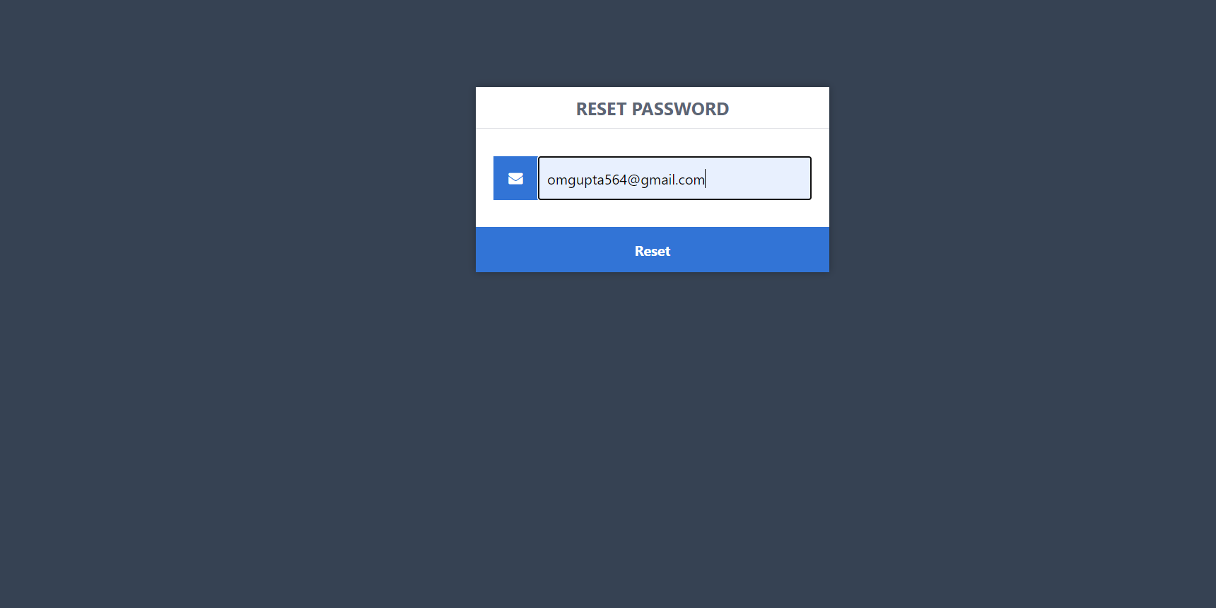
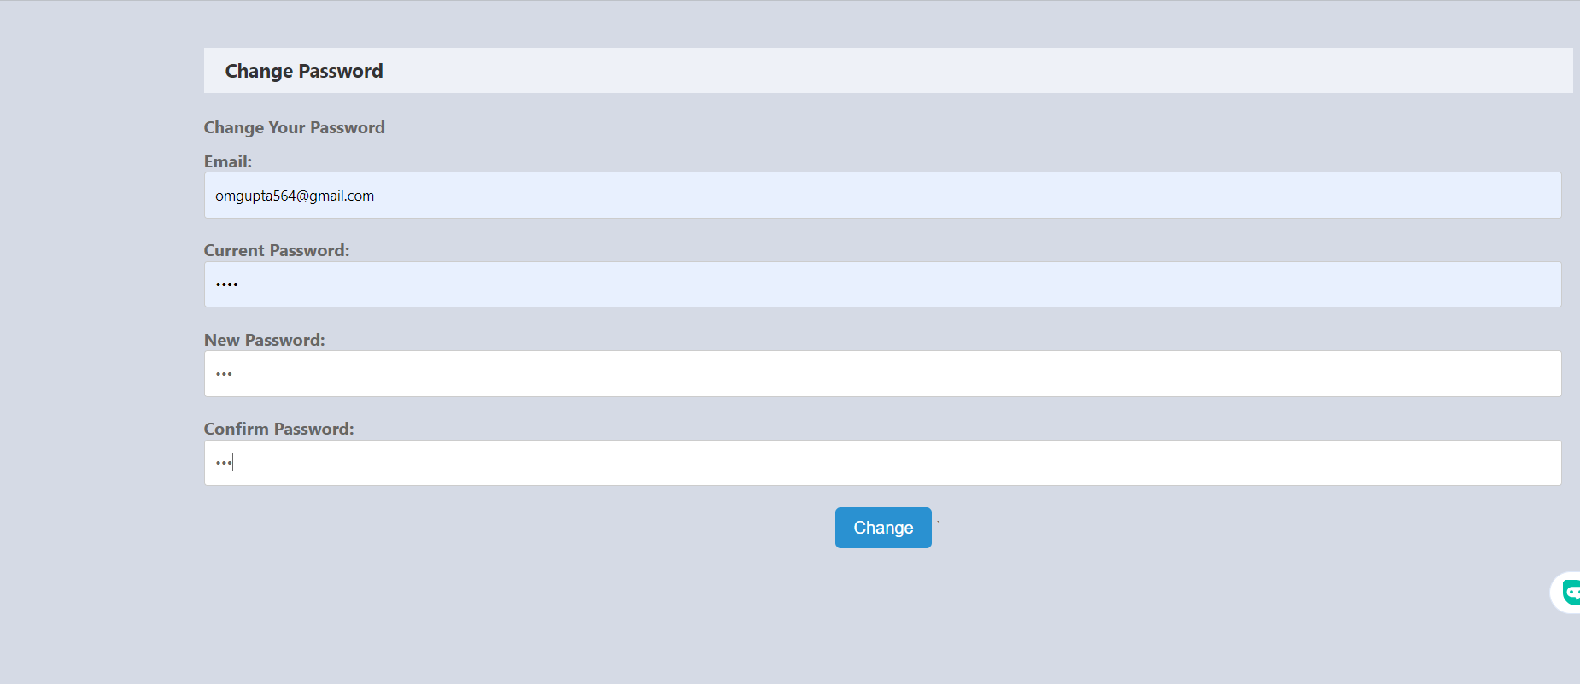
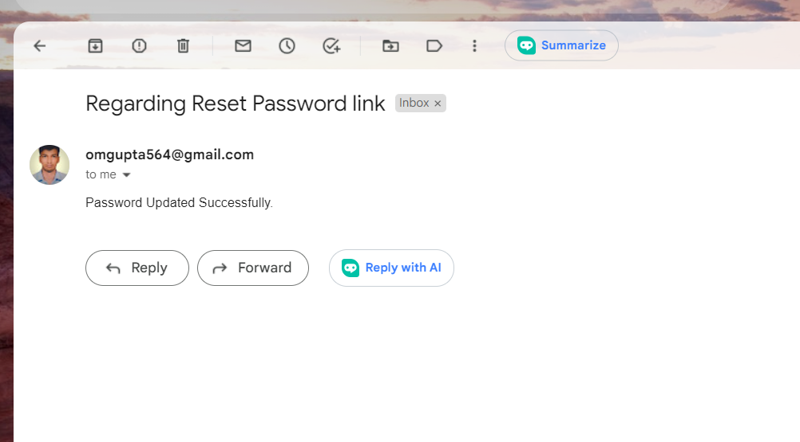

Slide 30
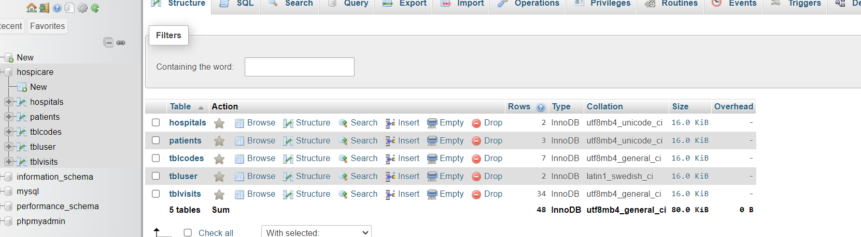
Database Schema

Slide 31
Working Video
Link
~video1197393099.mp4
~http://localhost/Doctopro/

Slide 32
Conclusion
In conclusion, DOCTOPRO presents a robust and reliable solution in the form of a Secure Authenticator Key System. This system addresses critical security concerns in today's digital landscape and offers a range of benefits for users and organizations alike. The key takeaways and conclusions regarding DOCTOPRO's Secure Authenticator Key System are as follows:
Enhanced Security: DOCTOPRO's Secure Authenticator Key System offers an advanced and multi-layered approach to security. It significantly reduces the risk of unauthorized access and data breaches, making it an ideal choice for safeguarding sensitive information.
User-Friendly: While being highly secure, DOCTOPRO also prioritizes user-friendliness. The system is designed to be accessible and convenient for users, ensuring a seamless experience without compromising security.
In summary, DOCTOPRO's Secure Authenticator Key System is a powerful, adaptable, and user-friendly security solution

Slide 33
Reference
Papers for references:-
https://drive.google.com/open?id=1hlLIC6jdKRI0IgXczOc23cLYfVSYcsj0
https://drive.google.com/open?id=1hlLIC6jdKRI0IgXczOc23cLYfVSYcsj0
https://drive.google.com/open?id=1Ze920zhziRdW-S_JD0nhpxdHw6Hl0oza
https://drive.google.com/open?id=1PBMMGIpaFyeLiGjluotI-gcSH_MQ3Rb7
https://drive.google.com/open?id=1BSTc2lN8Wn75GHGI_DxO8B9geG59Vb2F
https://drive.google.com/open?id=117ALJkLmKMYARB1YQV3chlNj7LoPl4CP
https://drive.google.com/open?id=19uOqdXkad9a33hAwpo5YIuTX3CrsmZZl
https://drive.google.com/open?id=128QGI95DIBuHqhKa4w1CIXpKDmfrdPEC
https://drive.google.com/open?id=1Q67knkQsjpdYdYFAYAL-gmEb-4kThw7Z
https://drive.google.com/open?id=1JSK0-Q5nQuuvi2tMnFD_gEas2djiiO7a
https://drive.google.com/open?id=1_2WZfZfTE4Enjkxp8hksLNtec1vNOAAD
https://drive.google.com/open?id=1YzUOCEV7YOJIEYEyGkkjWCOGRMjQ2b6Y
https://drive.google.com/open?id=1icMnfAKPfSeCzx5AohEBt9vn_qAGlVlv
https://drive.google.com/open?id=1slj3OBzS1sXZ8pLSGpXJHe10us2VKva2

